Slide 1

STOCK PRICE PREDICTION USING SOFT COMPUTING Represented By Shubham Agarwal (169105188)
Under The Guidance Of
DR. Sunita Singhal

Slide 2
INTRODUCTION
Our aim is to present a hybrid model to forecast stock price by analyzing different trends of stock market. As the stock price are time series but they are not static and highly noise due to the fact that stock market is not stable as it depends on various factors.
Here we are trying to implement a better model for the stock prediction using multiple predicting models and training our neural network from the output of those models as input.
We have referenced few research papers and have looked into few of the data prediction models and due to lack of experience in data science we are presently working on understanding the data manipulation using python and its libraries and few predicting algorithms.

Slide 3
MOTIVATION
The stock data are most challenging as because they are dynamic, non-liner and no common parameter. So it’s very difficult for the investors to predict stock price without analyzing trends of stock price
The present models that I have found till now have very less accuracy so , this is attempt to make a better model.

Slide 4
LITERATURE REVIEW
Many researchers have worked on stock market prediction. All researches have different feature of selecting the models using soft computing techniques.
Most of the intelligent soft computing techniques are developed over the last two decades.
The main intention of forecasting is to reduce the risk in decision making that is essential for monetary organizations, firm and personal investors.
The problem of trade industry and financial forecasting have newly tense the attention of a lot of researchers. The stock market prediction is a very complicated dynamic system.

Slide 5
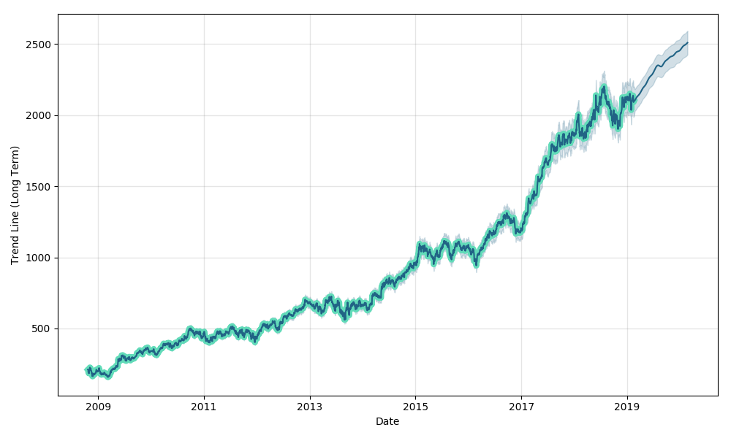
GRAPHICAL REPRESENTATION OF STOCK PRICE OF HDFC

Slide 6
We are using secondary data from the website of Bombay stock exchange from which we will be using the date as independent variable to predict the high price and low price from the data of last 10 years.
We have thought of implementing an hybrid algorithm that will use results from multiple predicting algorithms to train the ANN
We have data of hdfc stock price and we will be trying to predict its future stock price .

Slide 7
METHODOLOGY/PLANNING OF WORK
Presently we are improving our data science skills to understand and implement the models(as said :investing time to sharpen the axe is necessary)
We will be studying few more algorithms and will compare their accuracy and will finalize on three algorithms ,whose output we will use train neural network.
The trained neural network will predict the stock price for us

Slide 8
REFERENCE
Kyoung Jae kim, Ingo Han, Genetic algorithms approach to feature discretization in ANN for prediction of stock price index. Expert Systems with Applications, Elsevier, 2000. 0957- 4174/00027-0
Y.-F. Wang, \Predicting stock price using fuzzy grey prediction system," Expert Systems with Applications, vol. 22, no. 1, pp. 33-38, 2002.
P. Falinouss, \Stock trend prediction using news articles: a text mining ap-proach," 2007.
C. N. Tan and G. E. Wittig, \A study of the parameters of a backpropaga-tion stock price prediction model," in Arti cial Neural Networks and Expert Systems, 1993. Proceedings., First New Zealand International Two Stream Conference on, pp. 288-291, IEEE, 1993.
R. J. Kuo, C. Chen, and Y. Hwang, \An intelligent stock trading decision support system through integration of genetic algorithm based fuzzy neural network and artificial neural network," Fuzzy Sets and Systems, vol. 118, no. 1, pp. 21-45, 2001.

Slide 9
K. Bataineh, M. Naji, and M. Saqer, \A comparison study between various fuzzy clustering algorithms," EDITORIAL BOARD, vol. 5, no. 4, p. 335, 2011.
Arun Vahedi, and Shubham Agarwal \The predicting stock price using artifcial neural network," J. Basic. Appl. Sci. Res, vol. 2, no. 3, pp. 2325-2328, 2012
E. E. Peters, Chaos and order in the capital markets: a new view of cycles, prices, and market volatility. John Wiley & Sons, 1996.(related to stock market)
How Can We Predict The Financial Markets By Using Algorithms? University Lecture By Dr. Lipa Roitman

Slide 10
THANK YOU

